Slide 1
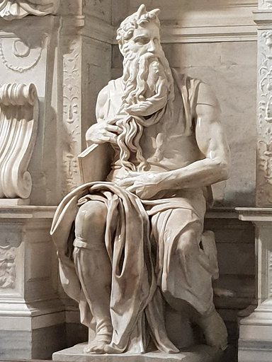
The 10 Commandments
of God's Law

Slide 2
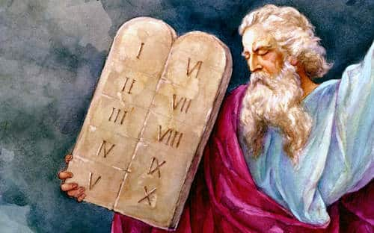
They are a gift from God.
We have it recorded in
our heart.
With sin the heart remains
dirty and we can't see
the Commandments.
God gives them to Moses.
Whoever ignores it hurts himself and others.
They are in the negative to make it clearer.
We fulfill them out of love.
The 10 Commandments

Slide 3
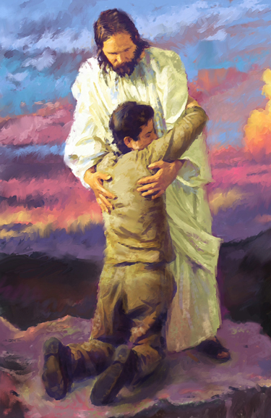
You will love God above all things.
There is an order in the things we love.
First God then others.
When I fulfill the other commandments, I fulfill this one.
The 10 Commandments

Slide 4
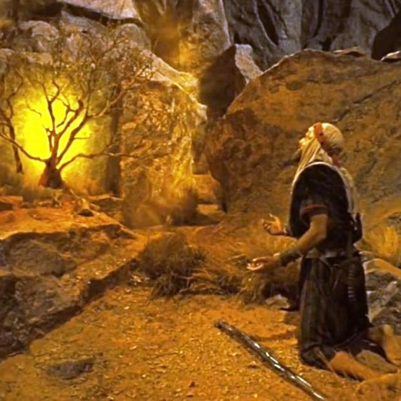
You shall not take God's name in vain.
God is holy and therefore his name is too.
You don't play with sacred things.
God is the most worthy of all.
We can't joke with Him.
The 10 Commandments

Slide 5
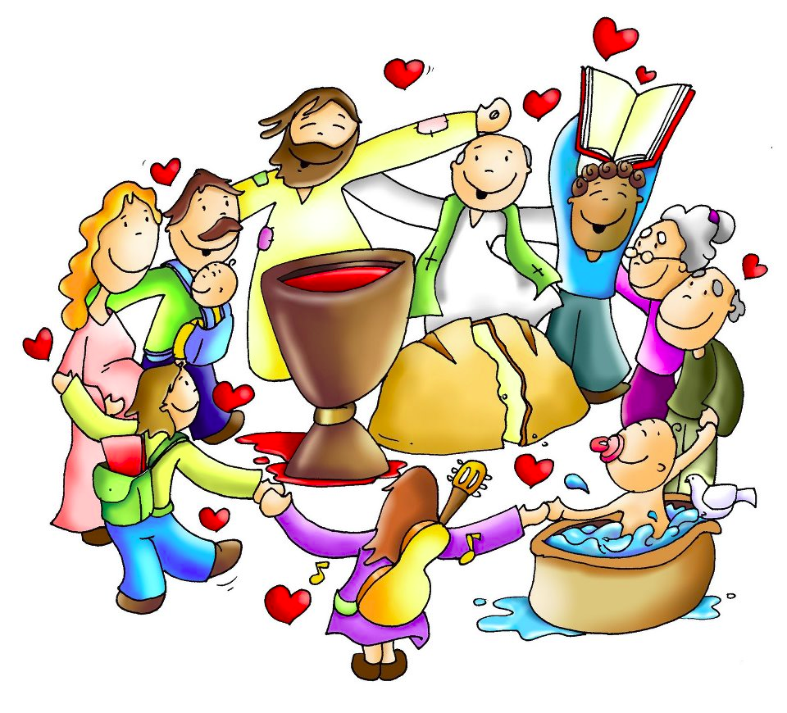
You will sanctify the holidays
God wants one day a week dedicated to Him.
Also to rest from work.
Let's go to Mass and do things that don't offend God.
The 10 Commandments

Slide 6
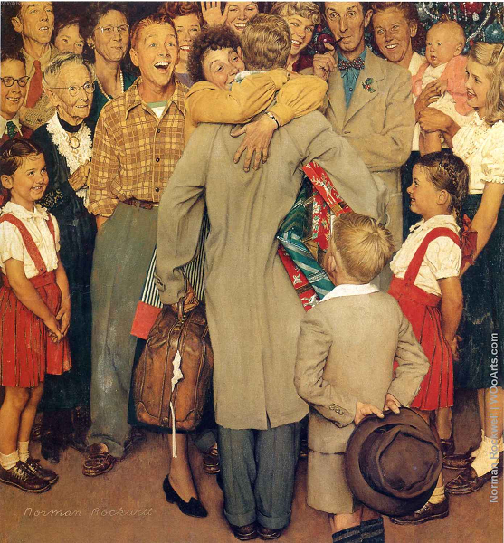
You will honor your father and mother.
We are born into life and love linked to a family.
They take care of us and educate us when we are young.
We take care of them as adults.
Prayer, respect and obedience.
The 10 Commandments

Slide 7
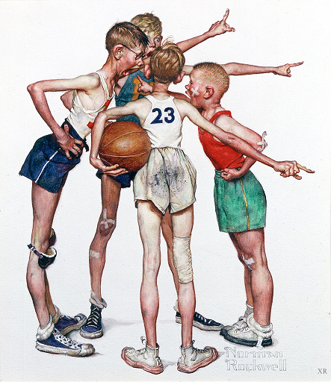
You shall not kill.
Hate is the opposite of God.
Anything that involves harassment, insults, fights, beatings, injuries,... is fatal.
The Christian loves everyone and forgives everything.
The 10 Commandments

Slide 8
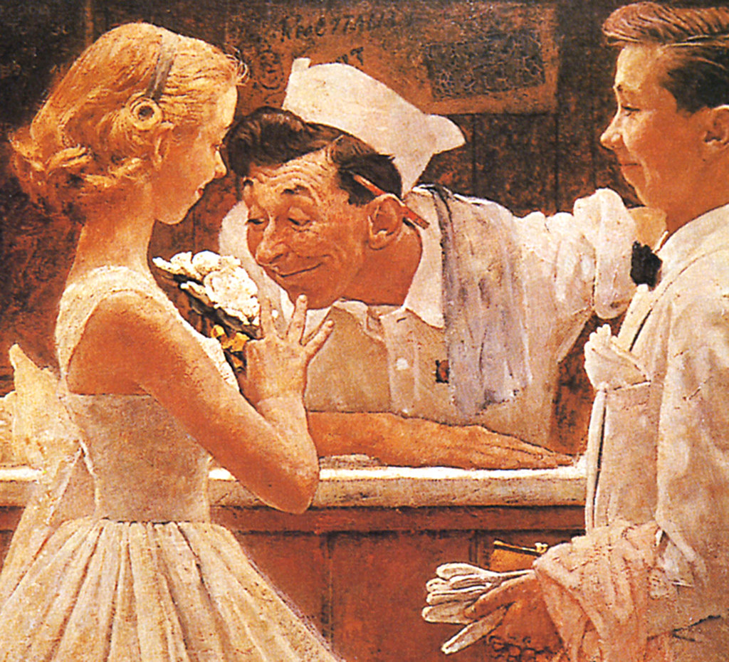
You shall not commit impure acts.
We treat people with respect.
We can't see it as if it were a toy.
Women and men respect each other's bodies.
The 10 Commandments

Slide 9
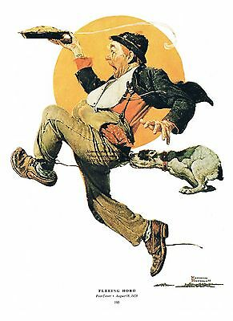
You shall not steal.
We respect private property.
Things are taken with permission.
Studying is taking advantage of your parents' money.
The 10 Commandments

Slide 10
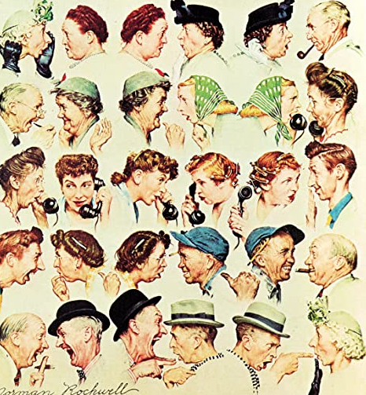
You shall not bear false witness or lie.
We respect the truth.
Lying destroys trust and friendship.
We must take care of the honor of others.
The 10 Commandments

Slide 11
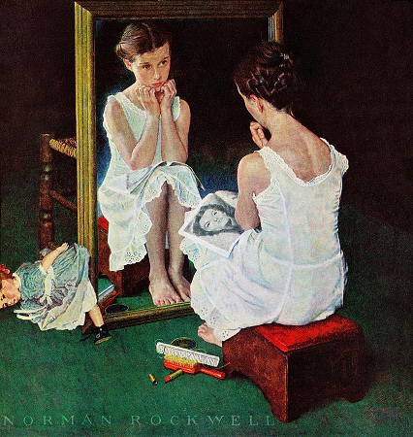
You will not indulge in impure thoughts or desires.
I am who I am. God made me this way because he likes me.
Modesty preserves the purity of the heart.
Imagination deceives us, we don't pay any attention to it.
The 10 Commandments

Slide 12
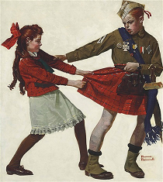
You shall not desire the goods of others.
Be content with what we have.
Leave things.
Take care of other people's things as if they were my own.
Greed distances us from others.
The 10 Commandments

